Slide 1
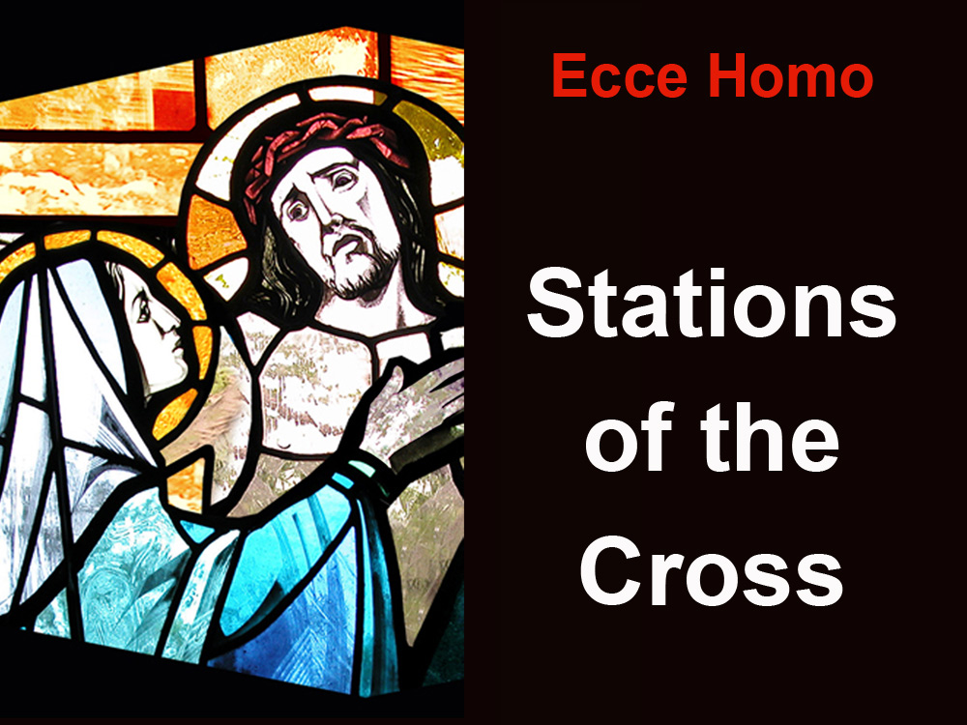

Slide 2
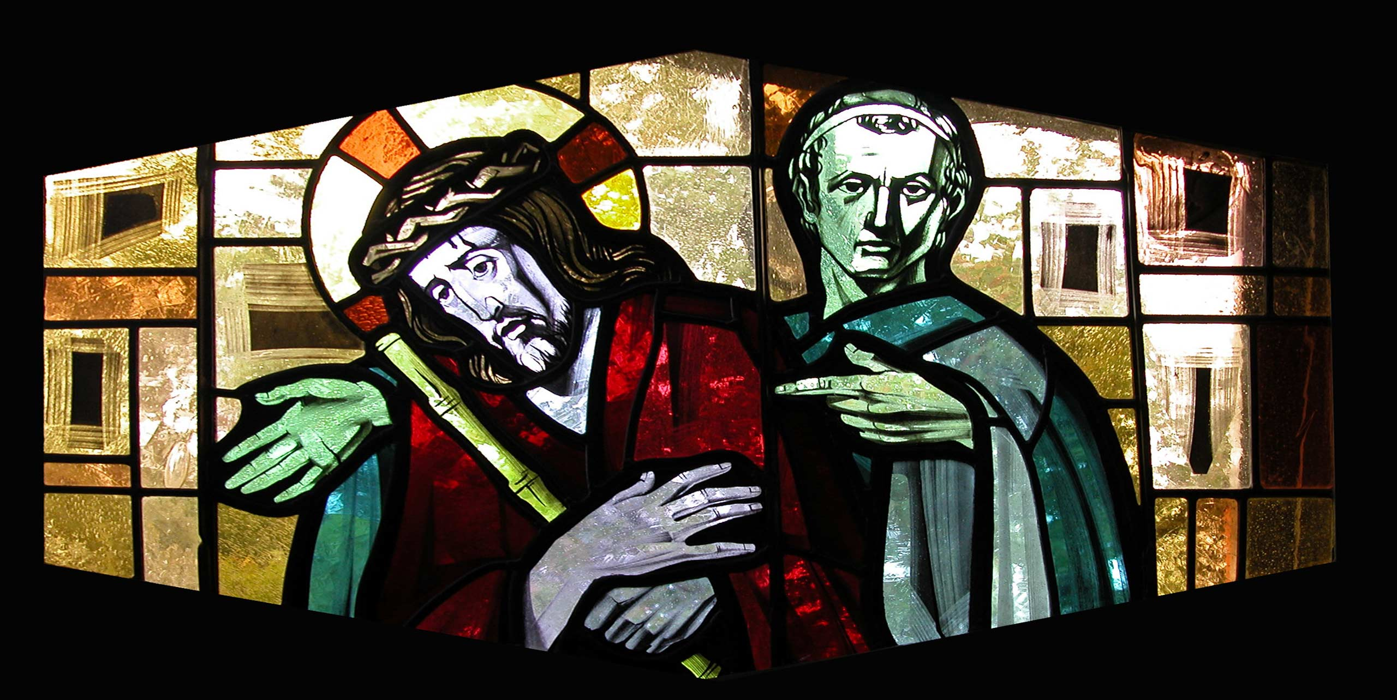
1. Jesus is judged

Slide 3
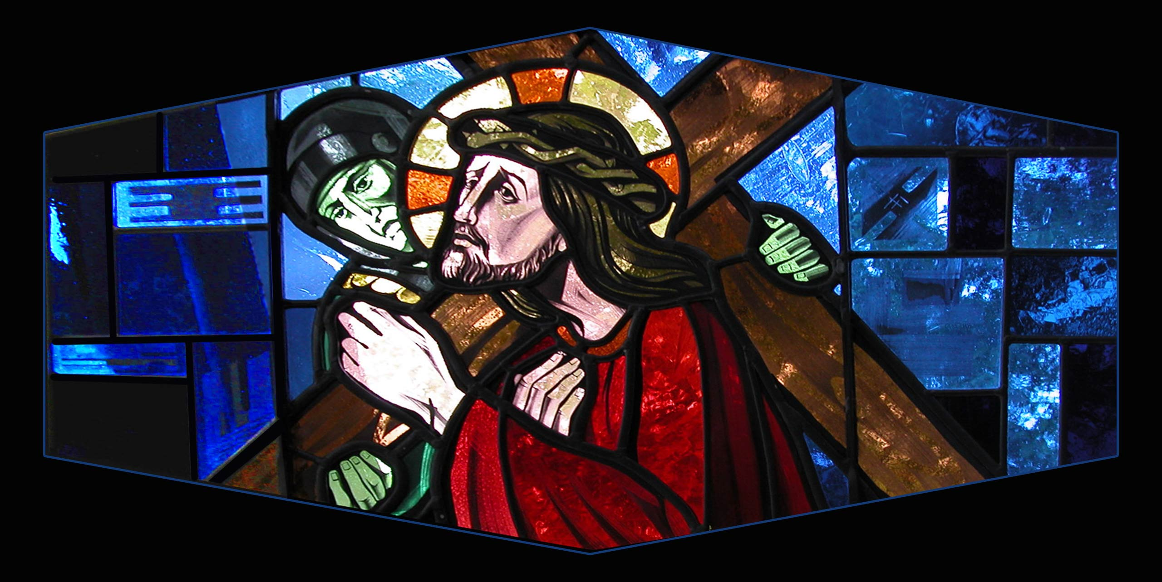
2. Jesus receives his Cross

Slide 4
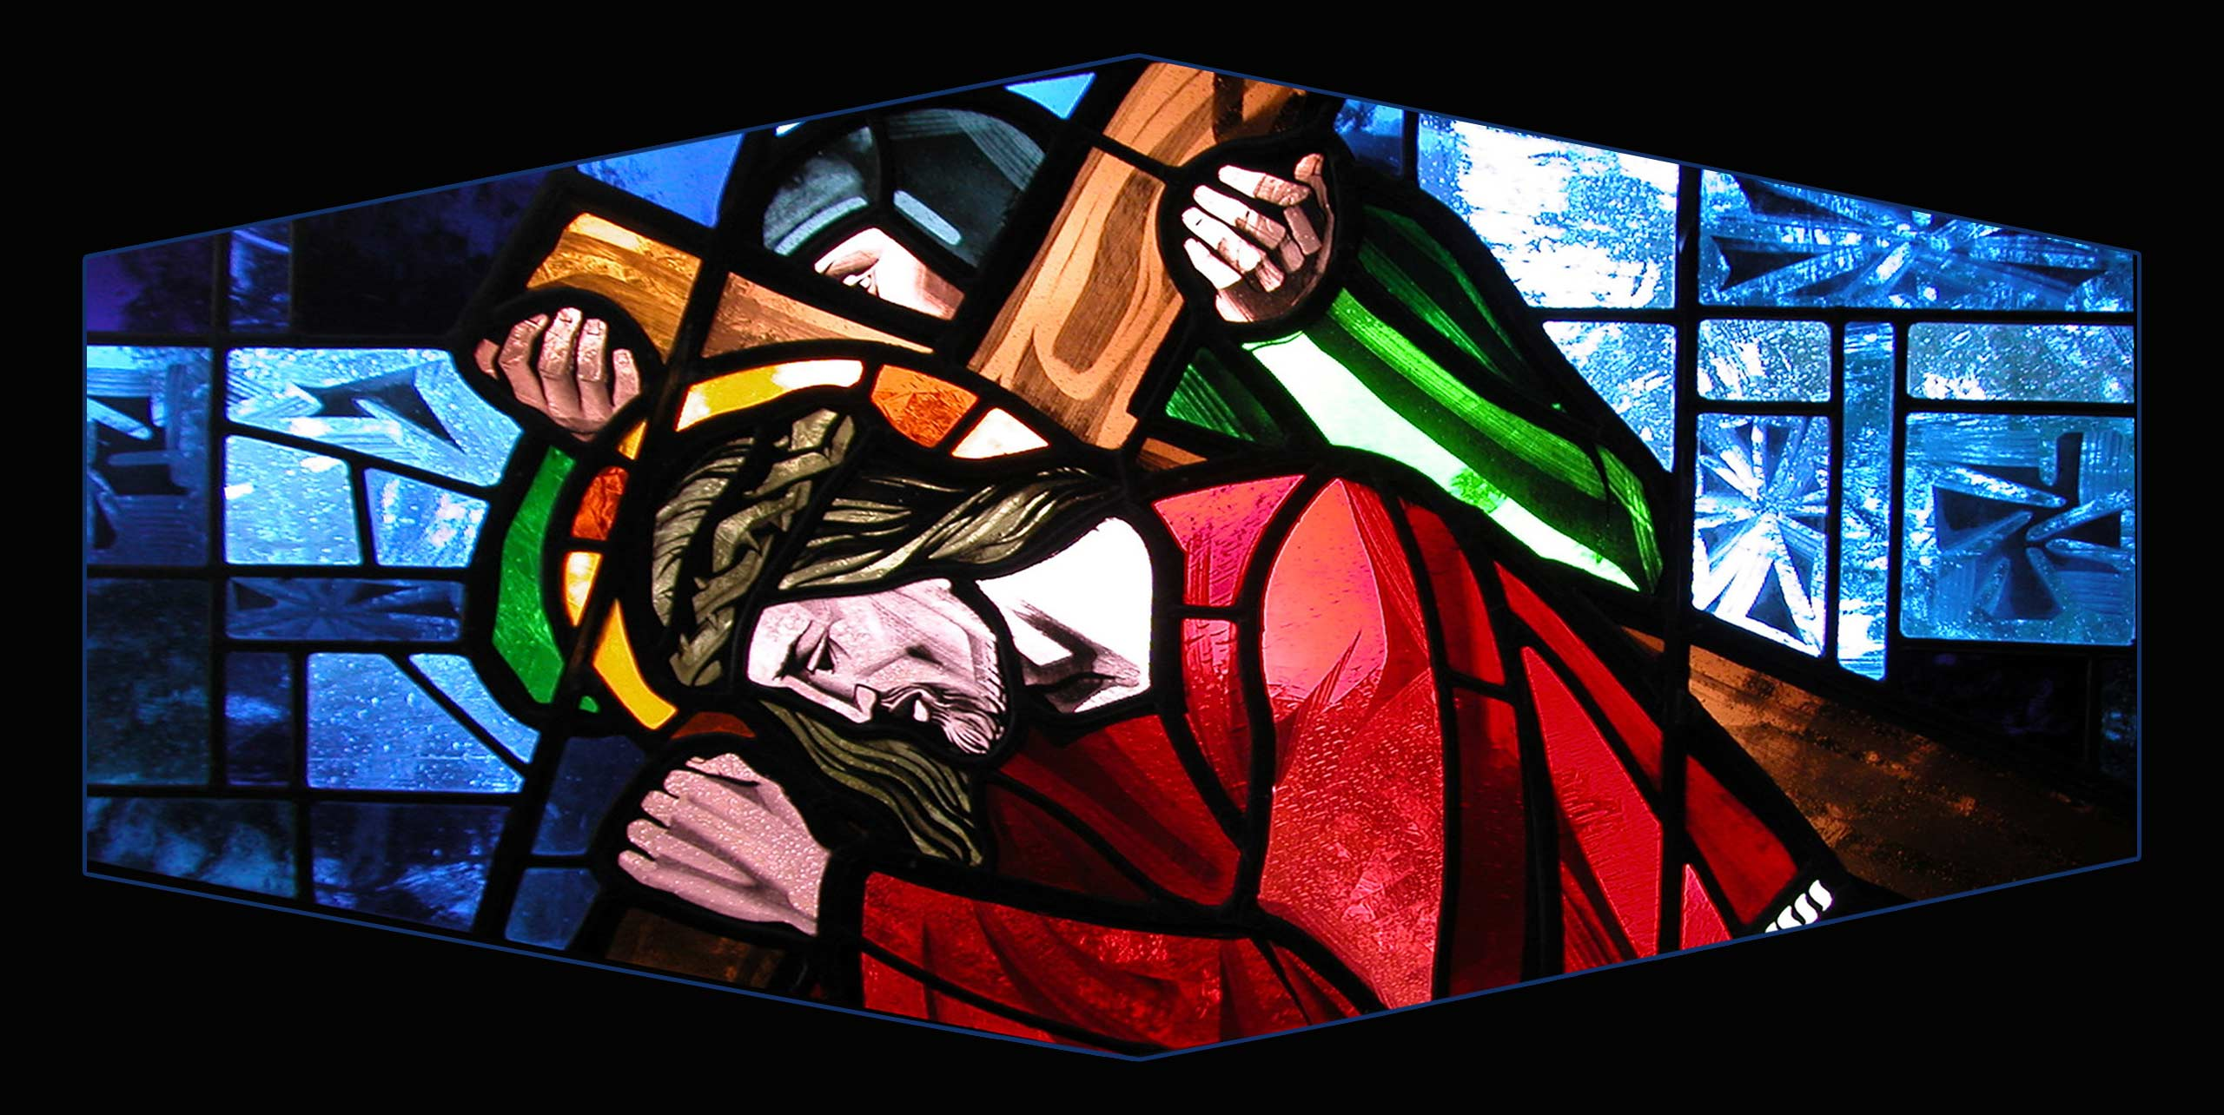
3. Jesus falls for the first time

Slide 5
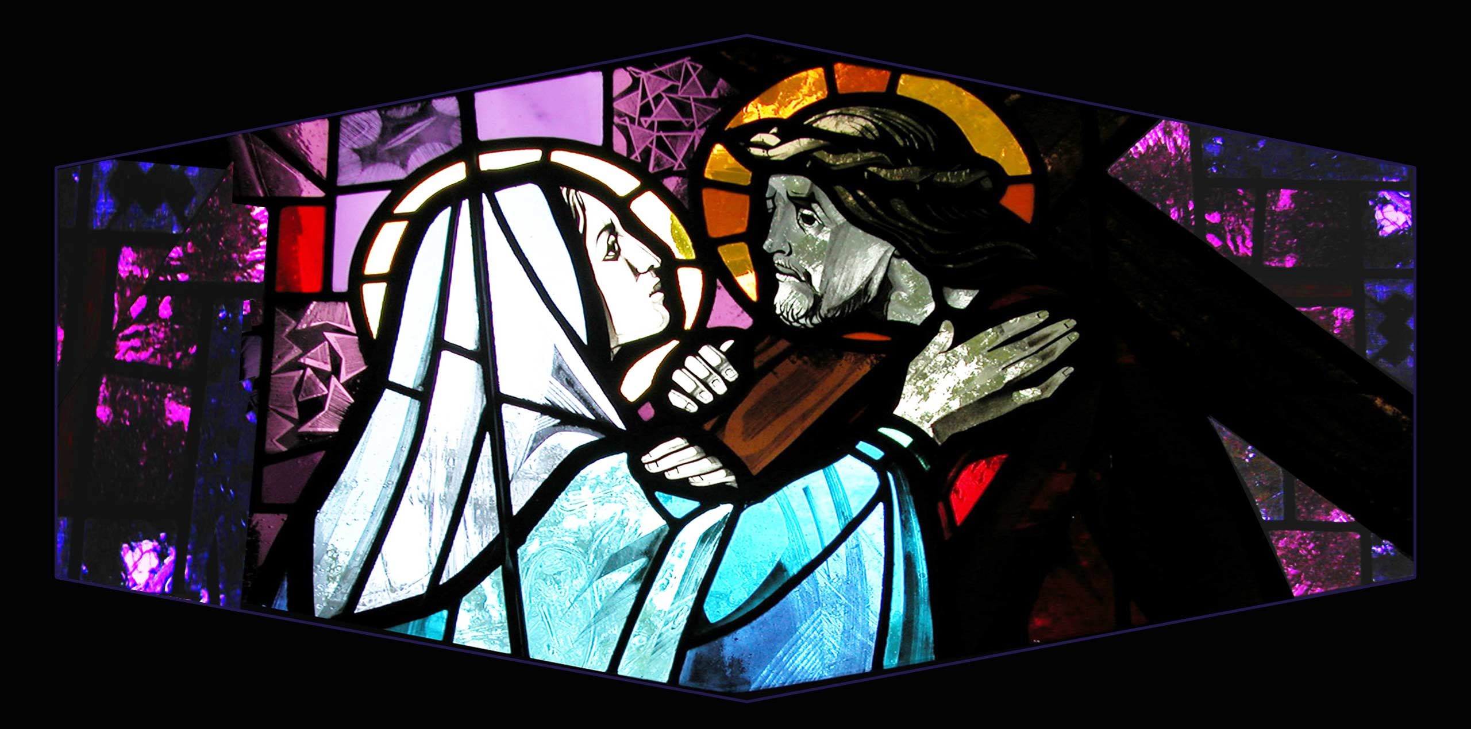
4. Jesus meets his Mother

Slide 6
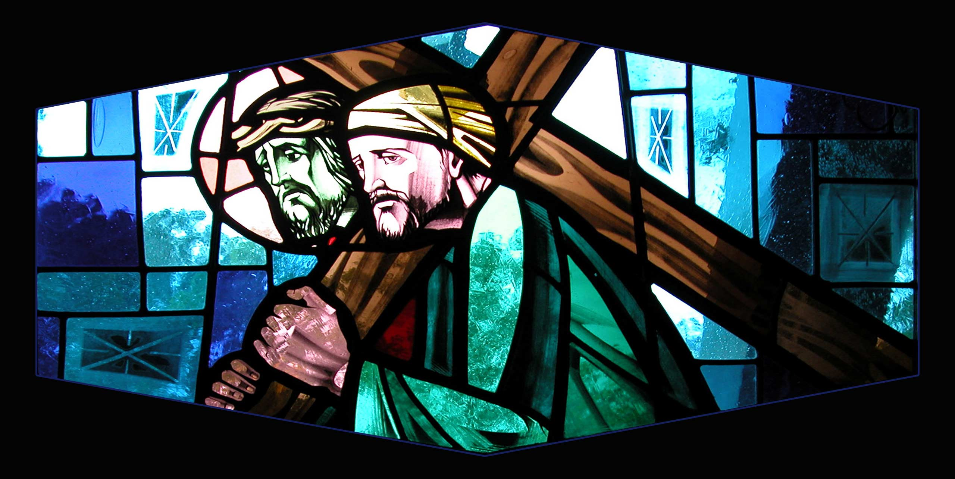
5. Simon of Cyrene helps Jesus carry the Cross

Slide 7
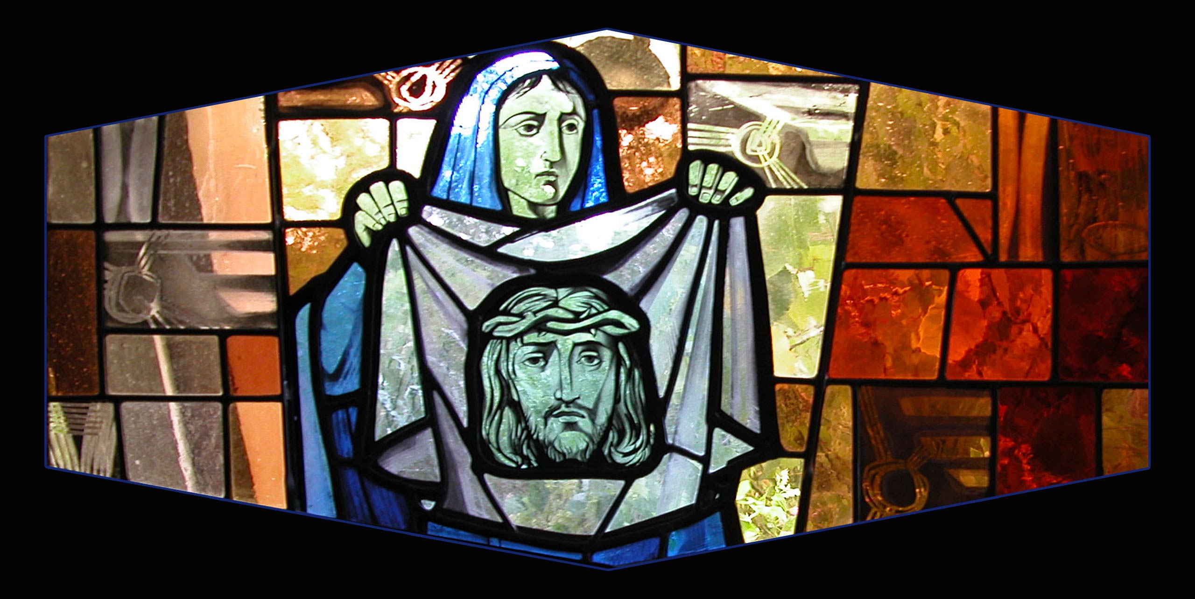
6. Veronica wipes Jesus’ brow

Slide 8
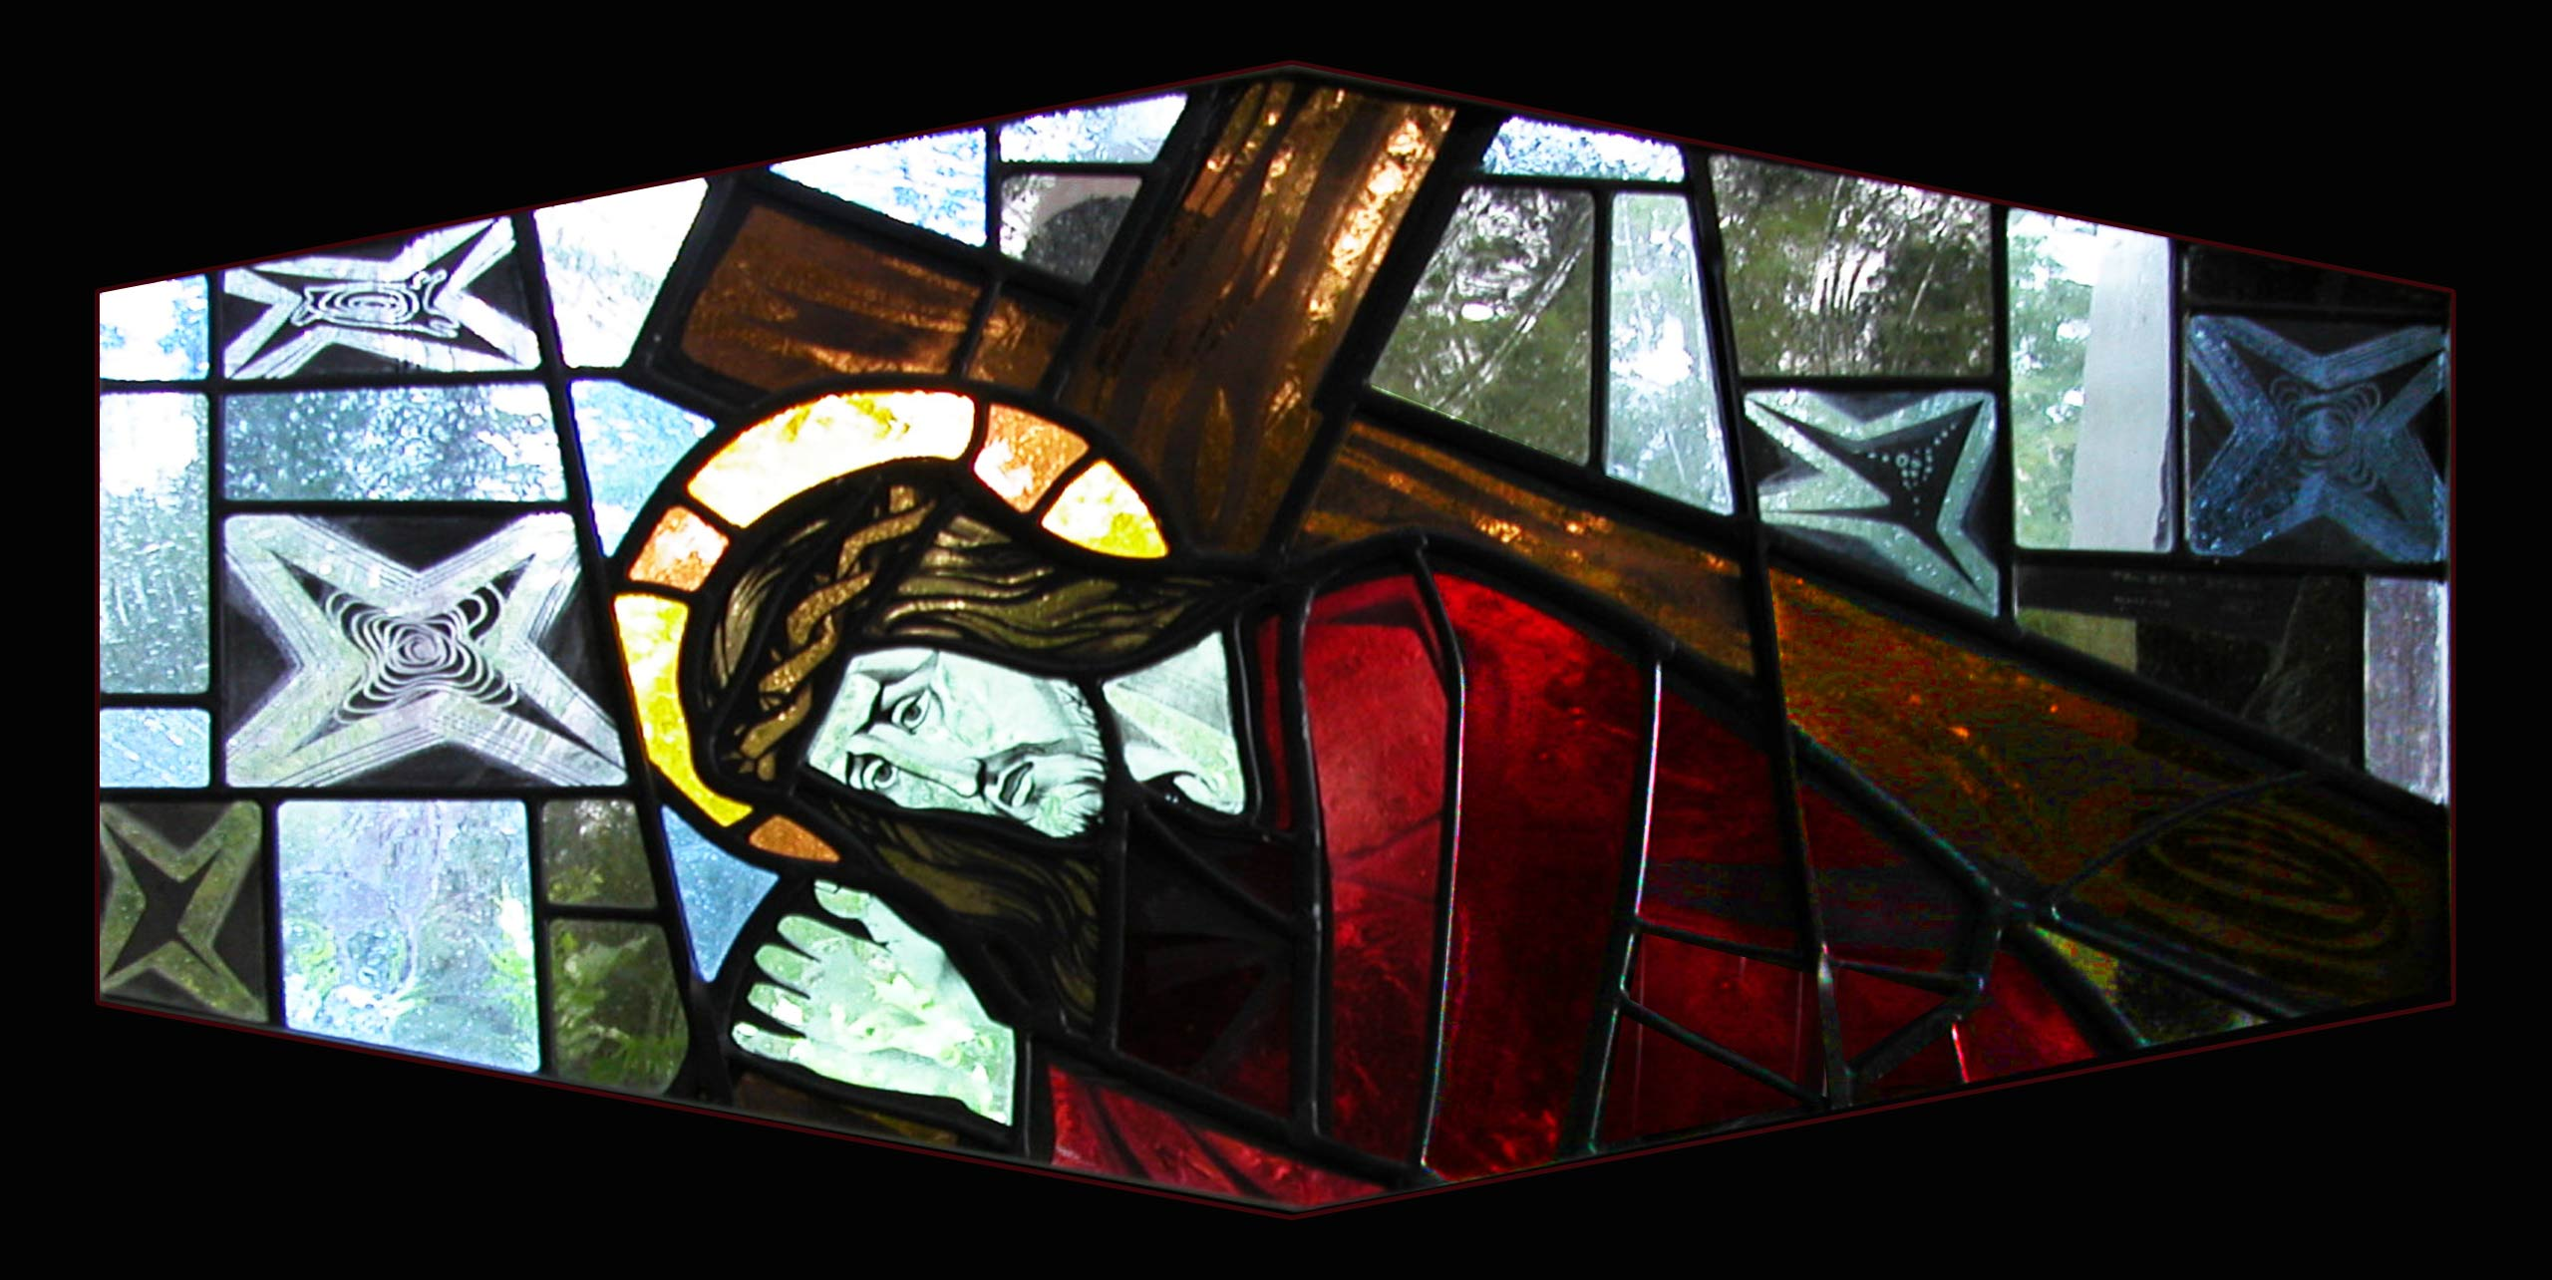
7. Jesus falls a second time

Slide 9
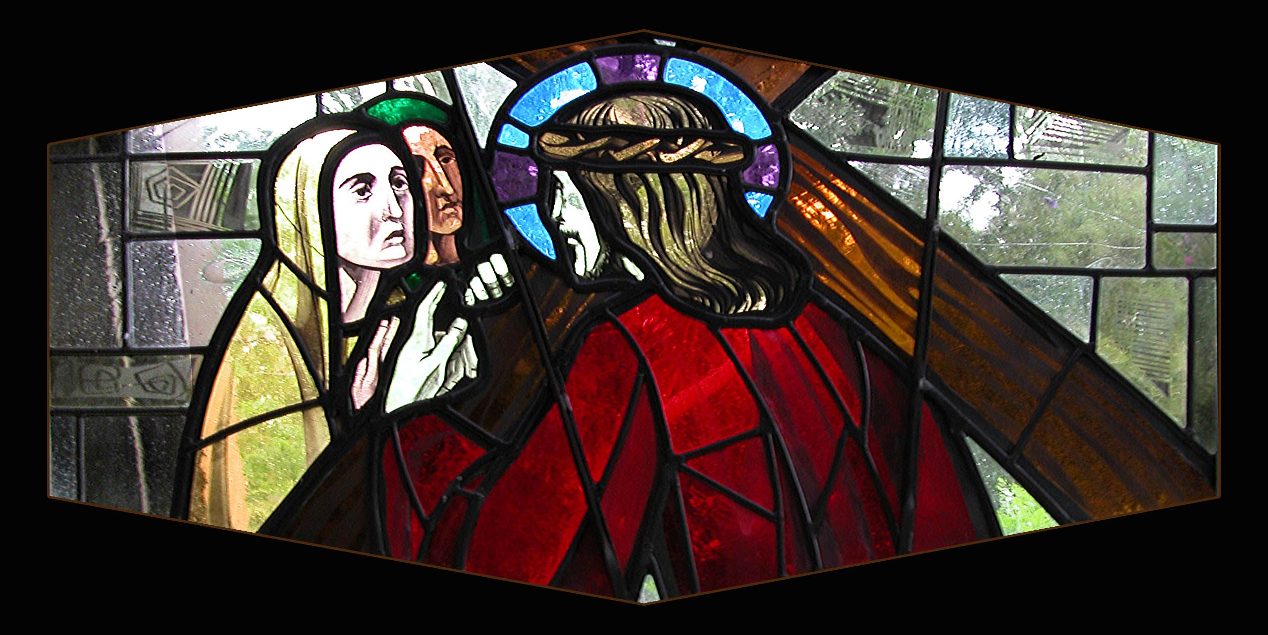
8. Jesus talks to the weeping women

Slide 10
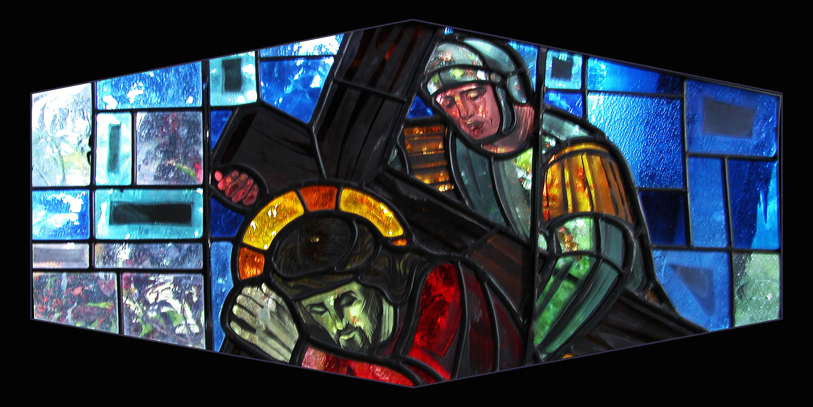
9. Jesus falls a third time

Slide 11
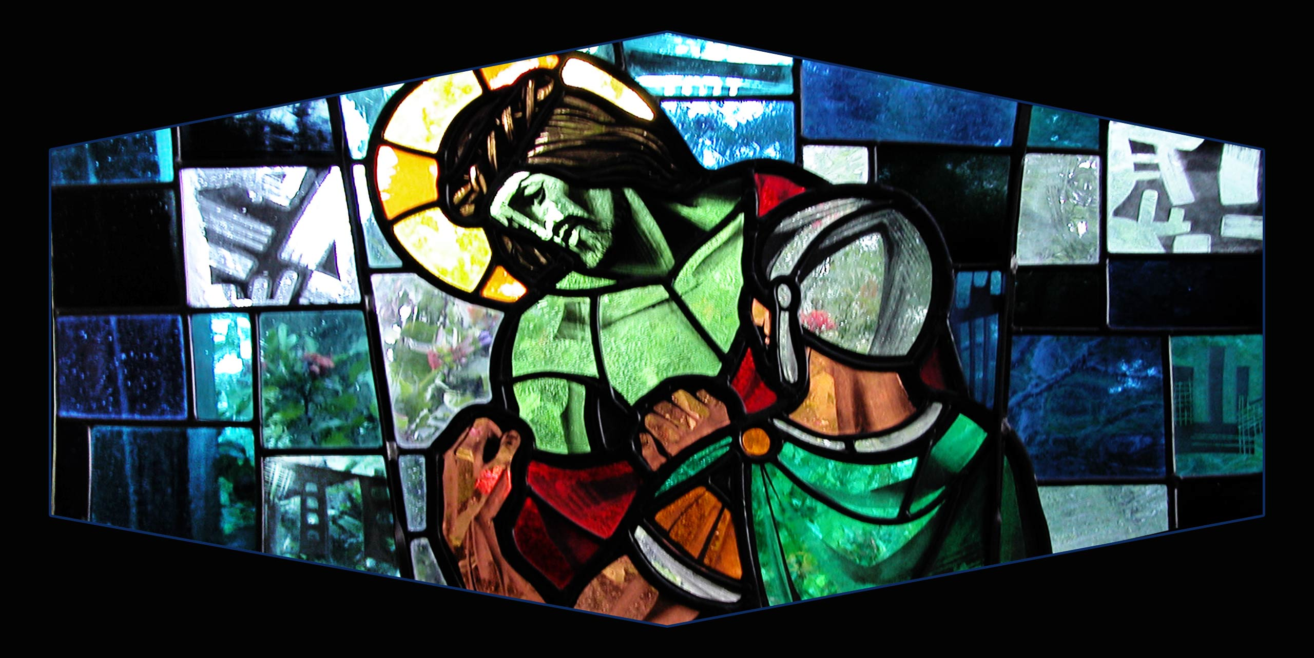
10. Jesus is stripped of his garments

Slide 12
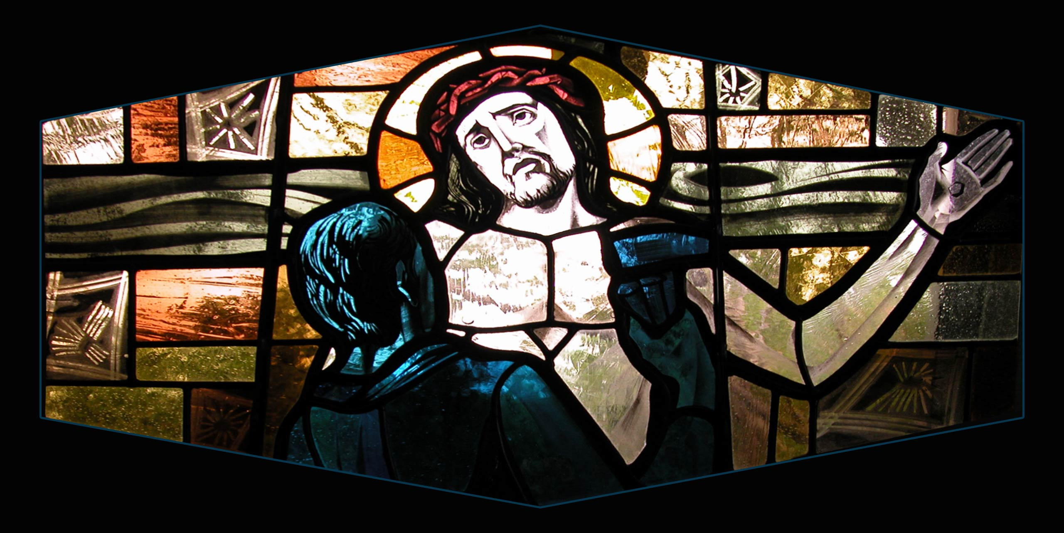
11. Jesus is crucified

Slide 13
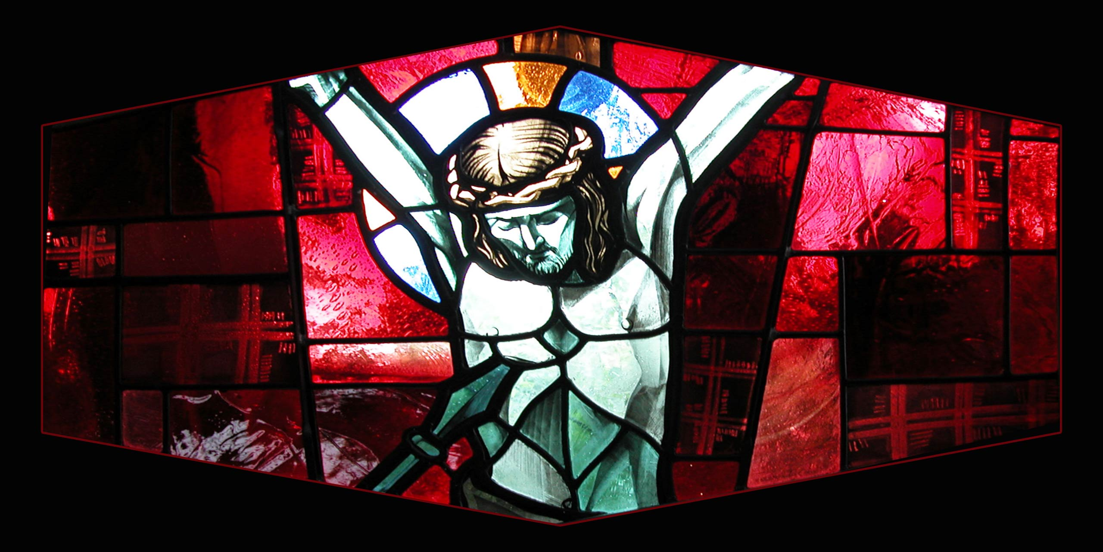
12. Jesus dies on the Cross

Slide 14
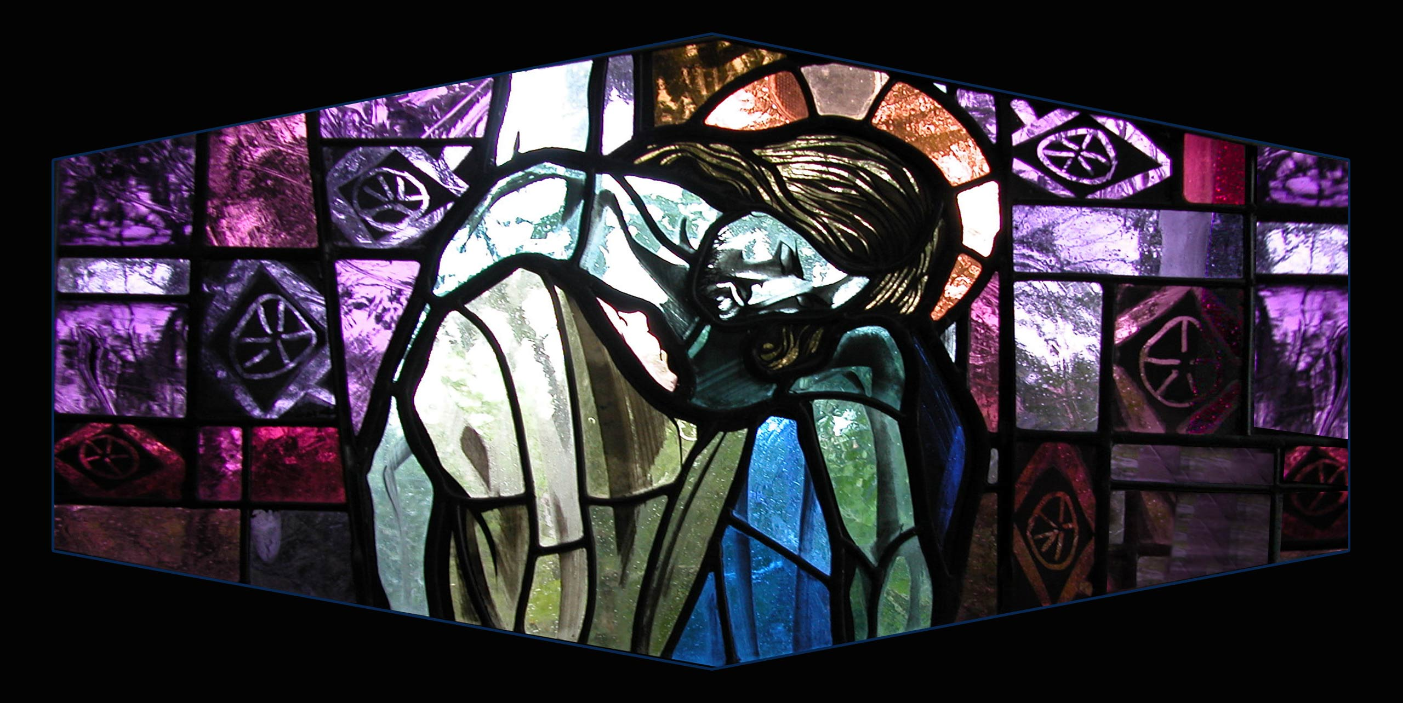
13. Jesus is taken down from the Cross

Slide 15
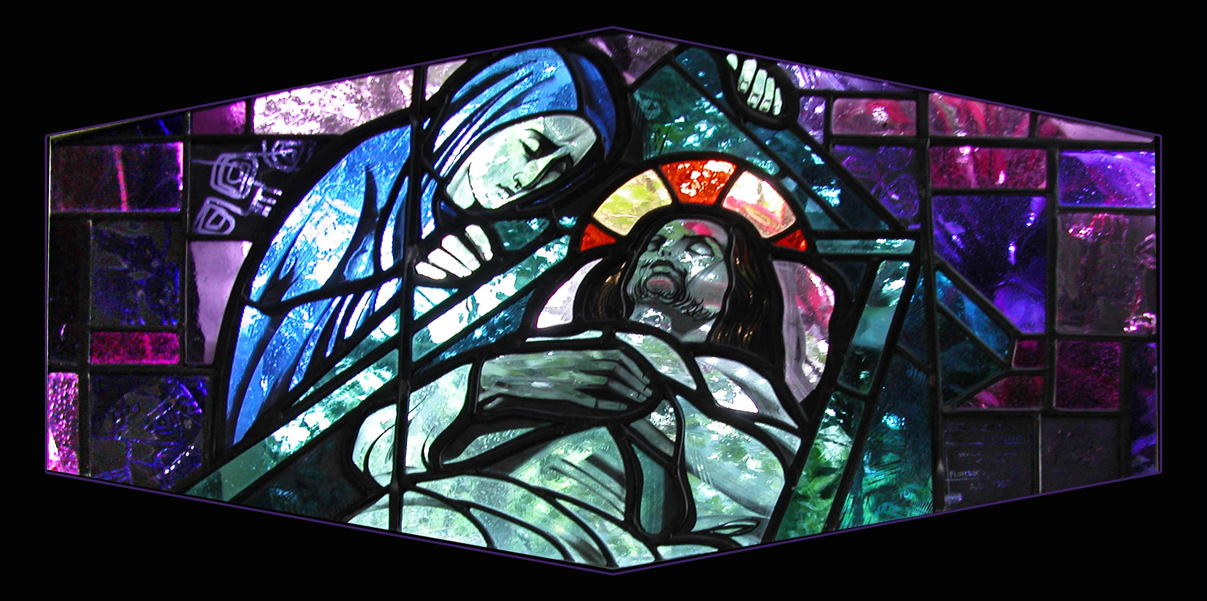
14. Jesus’ body is placed in the tomb

